Slide 1
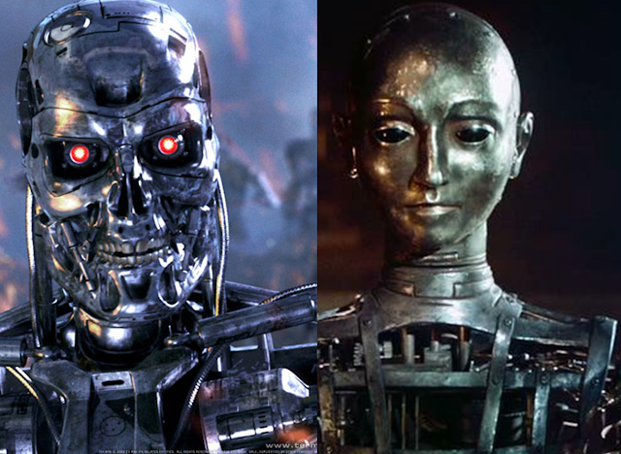
Theory Of Automata

Slide 2
Lecture # 05
Theory of Automata

Slide 3
Revision
Languages
Types of languages
Method of defining languages
Descriptive definition
Palindrome
Recursive way

Slide 4
Regular Expressions
One of the most common language defining method.
Provide concise matching of string.
Language is represented in terms of strings.
The concept is associated with the Kleenes formalism of regular sets introduced in 1950

Slide 5
Most implied language defining method
Used in so many programming languages including Java , C++ etc
One regular expression can define the whole language i.e. how many number of infinite strings a language has
It squeeze the infinite language in to a single expression.

Slide 6
Examples
Make a language contain all of the strings of ‘a’ only.
L={a,aa,aaa,aaaa,aaaaa,……..}
R.E = a⁺
Make a language contain all of the strings starts with ‘a’ and ends on any ‘b’.
L={a,ab,abb,abbb,abbbb,……}
R.E = ab*

Slide 7
Operators to define R.E.
Useful operators used in the regular expression are:
1: * = Kleene Closure = 0 or more
2: . = Concatenation = AND
3: + = Union = 1 OR more
Note: Substring is the A substring is a contiguous sequence of characters within a string.

Slide 8
A Regular Expression can be recursively defined as follows −
ε is a Regular Expression indicates the language containing an empty string. (L (ε) = {ε})
φ is a Regular Expression denoting an empty language. (L (φ) = { })
x is a Regular Expression where L = {x}

Slide 9
If X is a Regular Expression denoting the language L(X) and Y is a Regular Expression denoting the language L(Y), then
X + Y is a Regular Expression corresponding to the language L(X) ∪ L(Y) where L(X+Y) = L(X) ∪ L(Y).
X . Y is a Regular Expression corresponding to the language L(X) . L(Y) where L(X.Y) = L(X) . L(Y)

Slide 10
R* is a Regular Expression corresponding to the language L(R*)where L(R*) = (L(R))*
If we apply any of the rules several times from 1 to 5, they are Regular Expressions.

Slide 11
1:Concatenation of Strings
◦ is the concatenation operator
Example:
Suppose w1 and w2 are two strings
w1 = abc, w2 = def
w1 ◦ w2 = abcdef
w2 ◦ w1 = defabc
w2 ◦ w2 = defdef
Often drop the ◦: w1w2 = abcdef
For any string w, w €= w [€ = empty string]

Slide 12
We can concatenate a string with itself:
w¹ = w
w² = ww
w³ = www
By definition, w⁰ = €
Can reverse a string: w^{R}
abcde^{R} = edcba

Slide 13
Language Concatenation
We can concatenate languages as well as strings
L1L2 = {wv : w ∈ L1 ∧ v ∈ L2}
Example:
{a, ab}{bb, b} = {abb, ab, abbb}
{a, ab}{a, ab} = ?
{a, aa}{a, aa} = ?
What can we say about |L1L2|, if we know |L1| = m and |L2| = n?

Slide 14
We can concatenate a language with itself, just like
strings
L¹ = L, L² = LL, L³ = LLL, etc.
What should L⁰ be, and why?

Slide 15
L⁰ = {€}
{} is the empty language
{€} is the trivial language
Kleene Closure (L)
L* = L⁰ ∪ L¹ ∪ L² ∪ L³ ∪ . . .

Slide 16
2: Union of Strings
Use of OR (+) operator for regular expression:
a|b = a or b = (a+b) = {a,b} = {a} U {b}
(a|b)* = (a or b) 0 or more times
(a|b)⁺ = (a or b) 1 or more times
a|b* = a or b (only b 0 or more times)
(a|b)*(c|Λ) = (a or b) 0 or more times and c or Null string
Note: {a,b} = {a} U {b} are not a R.E

Slide 17
Convert the following into a Regular Expression.
1: {a,bc} =
2: {1,11,111,1111,……} =
3: {ab,a,b,bb} =
4: {a,ab,abb,abbb,abbbb,……..} =
5:

Slide 18
Regular Expression Examples
Expand the following R.E.
1: (a+b)* = ?
2: (a.b)* =
3: ((a*).(b*)) =
4: ((a+b)(b*)) =
5: (( (a+b)(b*))a) =
6: (a( (a+b)*)a) =

Slide 19

Lecture Summary
Recursive way
More Examples
Class Assignments
Regular Expressions
Operators used in R.E
Concatenation of String
Concatenation o Language
Union of String
Kleene Closure for Language
Example of R.E

